Slide 1
Exception Handling in .NET Core Web API
Handling exceptions effectively is crucial for building robust and user-friendly applications.
Hear we dives into exception handling in .NET Core Web API, showing how to create custom exceptions and manage them globally for a cleaner, more efficient codebase.
Why Exception Handling Matters
Properly handled exceptions ensure that your application behaves predictably under all circumstances.
It prevents sensitive error details from being exposed to the end user.
It provides meaningful feedback to users, enhancing their experience.
It makes the codebase easier to maintain and debug.

Slide 2
Exception Handling in .NET Core Web API
In ASP.NET Core Web API, handling exceptions properly is important for maintaining a reliable, user-friendly, and secure API. Here's how you can handle exceptions in Asp.net Core.
1. Use try-catch in Specific Actions(Optional)
2. Use UseDeveloperExceptionPage() Middleware (Simple Built-in Option)(Development Environment)
3. Use UseExceptionHandler Middleware (Simple Built-in Option)(Production Environment)
4. Use ExceptionFilter
5. Use builder.Services.AddExceptionHandler()-which is part of the new built-in exception handling middleware introduced in .NET 7+ for cleaner and declarative exception handling.
5. Use Global Exception Handling Middleware (Best Practice)

Slide 3
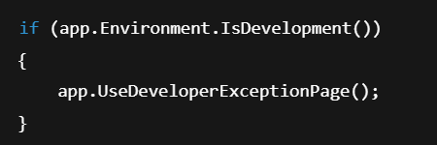
Exception Handling in .NET Core Web API
1.app.UseDeveloperExceptionPage()
For: Development Environment
✔️ Purpose:
Displays a detailed error page in the browser, including:
Stack trace
Request information
Query strings
Cookies
Headers
Route data
📌 When to use:
In the Development environment only — it helps developers debug issues.
🧪 Output example:
A full HTML page with:
Exception type
Message
Stack trace
Request details
🔐 Not safe for production:
Shows sensitive application internals!

Slide 4
Exception Handling in .NET Core Web API
2. app.UseExceptionHandler()
✅ For: Production Environment
✔️ Purpose:
Handles exceptions gracefully and returns a generic error response to the client without exposing internals.
You can configure it to log errors or return custom JSON:
🔐 Safe for production:
Doesn’t expose stack traces or sensitive data.

Slide 5
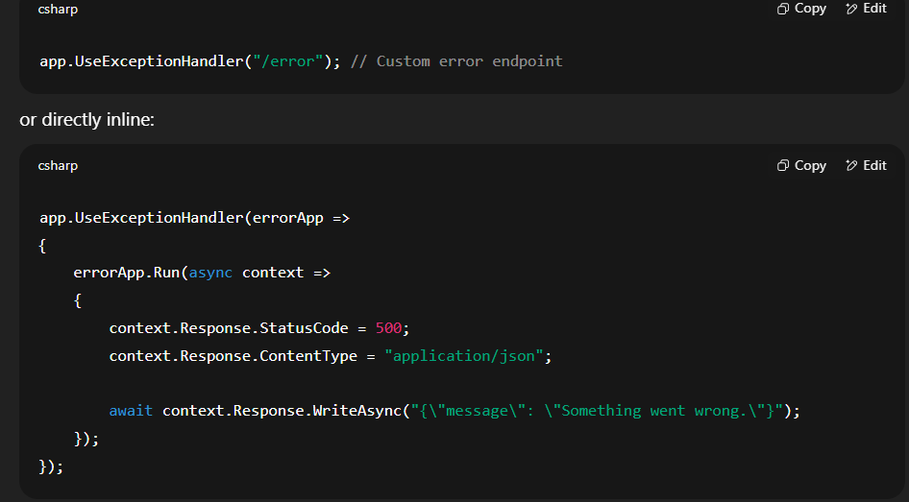
Exception Handling in .NET Core Web API

Slide 6
Global Exception Handling using Filter
Instead of scattering try-catch blocks throughout your code, .NET Core allows you to handle exceptions globally. This is done using middleware or filters. We’ll focus on using a global filter.
public class GlobalExceptionFilter : IExceptionFilter {
}
Registering the Global Filter
Builder.services.AddControllers(options => { options.Filters.Add(new GlobalExceptionFilter()); });

Slide 7
Global Exception Handling using Middlerware
var builder = WebApplication.CreateBuilder(args);
var app = builder.Build();
app.UseMiddleware<ExceptionMiddleware>(); // using exception Middleware
app.MapControllers();
app.Run();

